Slide 1

Capital Bikeshare Network Expansion
Customer Behavior and Analysis of Big Data for a profitable expansion

Slide 2
The Three “w”
Who?
Aaron Goldbeck is specialist in the Planning and Sustainability Division of The District Department of Transportation (DDOT)
We are hired by Goldbeck to study the large data collected by Capital Bikeshare over the years
The DDOT is seeing a growing competitive scene in the bike rental sector, and looking to gain advantage

Slide 3
The Three “w”
Why?
40 New bike rental stations have been approved
Gaining Insight on customer behavior and analysis of trends & patterns will allow us to gain the highest Return on Investment achievable
To better interpret demand variability and act accordingly
Analyzing will allow us to plan the expansion to best optimize the cashflow during low demand seasons and be ready for high demand seasons.
Promotions and customer offers will be better utilized and have a larger effect

Slide 4
The Three “w”
What?
Collected hourly data concerning members and new user behaviors as well as weather conditions over the course of two years.
year | month | day | hour | member | weekend | season | temperature | dewpoint
2016 | 10 | 1 | 0 | 80 | 1 | fall | 18.33 | 65
2016 | 10 | 1 | 1 | 53 | 1 | fall | 17.78 | 64
2016 | 10 | 1 | 2 | 27 | 1 | fall | 17.78 | 64
2016 | 10 | 1 | 3 | 20 | 1 | fall | 17.78 | 64
humidity | windspeed | windgust | pressure | precip | precipaccum | weather | rental
100 | 6 | 0 | 30.1 | 0 | 0 | 3 | 103
100 | 10 | 0 | 30.1 | 0 | 0 | 3 | 63
100 | 10 | 0 | 30.1 | 0 | 0 | 3 | 33
100 | 10 | 0 | 30.1 | 0.1 | 0 | 3 | 23

Slide 5
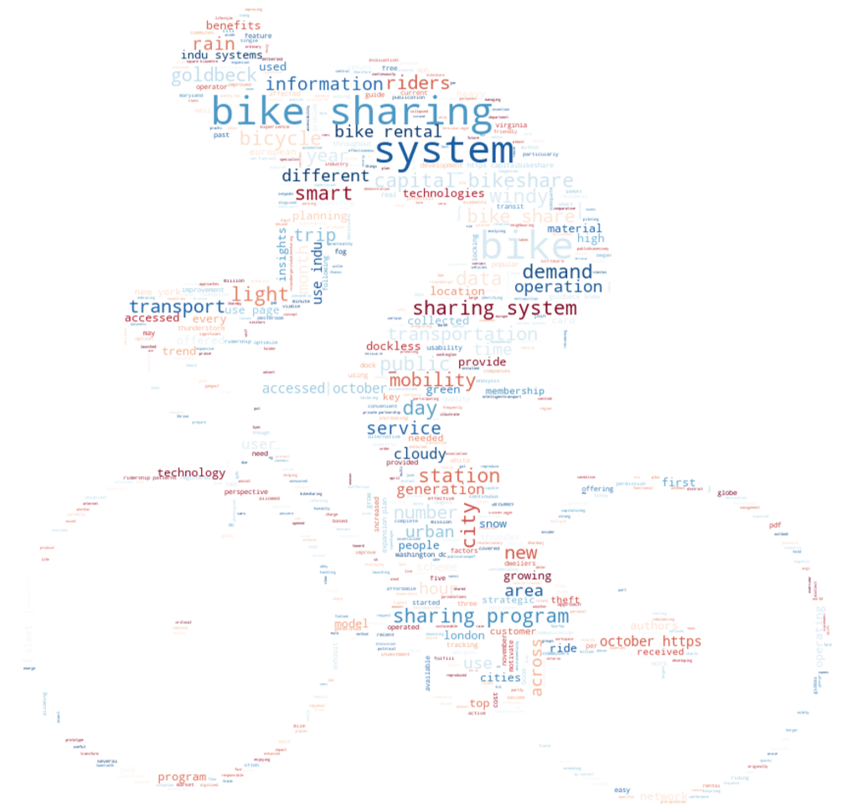
Key Words

Slide 6
Key insights and assumptions
Geographical Locations and Network data is neglected for now
Quantitative Monetary Gain Analysis will not be considered in this report
Execution plan of expansion will not be included in the current study
Marketing and Advertising plans will also be ignored
The comparisons will be done for 2017 and 2018 only
Our analysis will be constrained by the given Data table only. No External Data will be considered

Slide 7
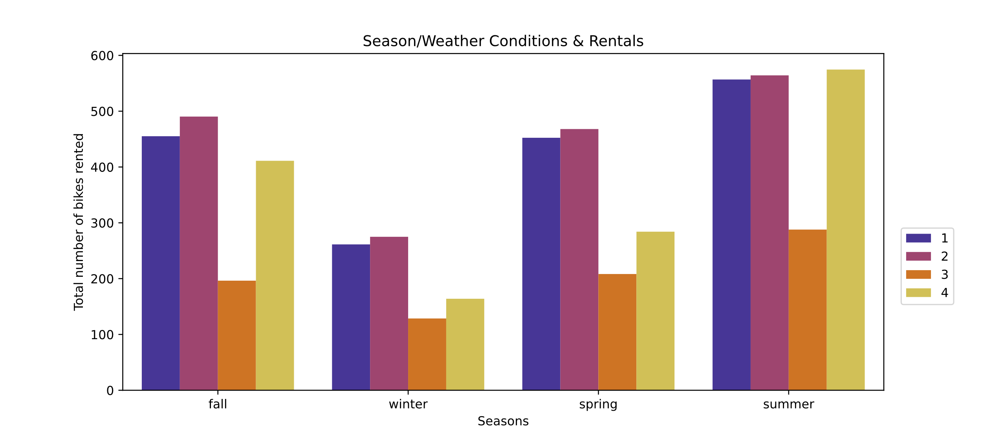
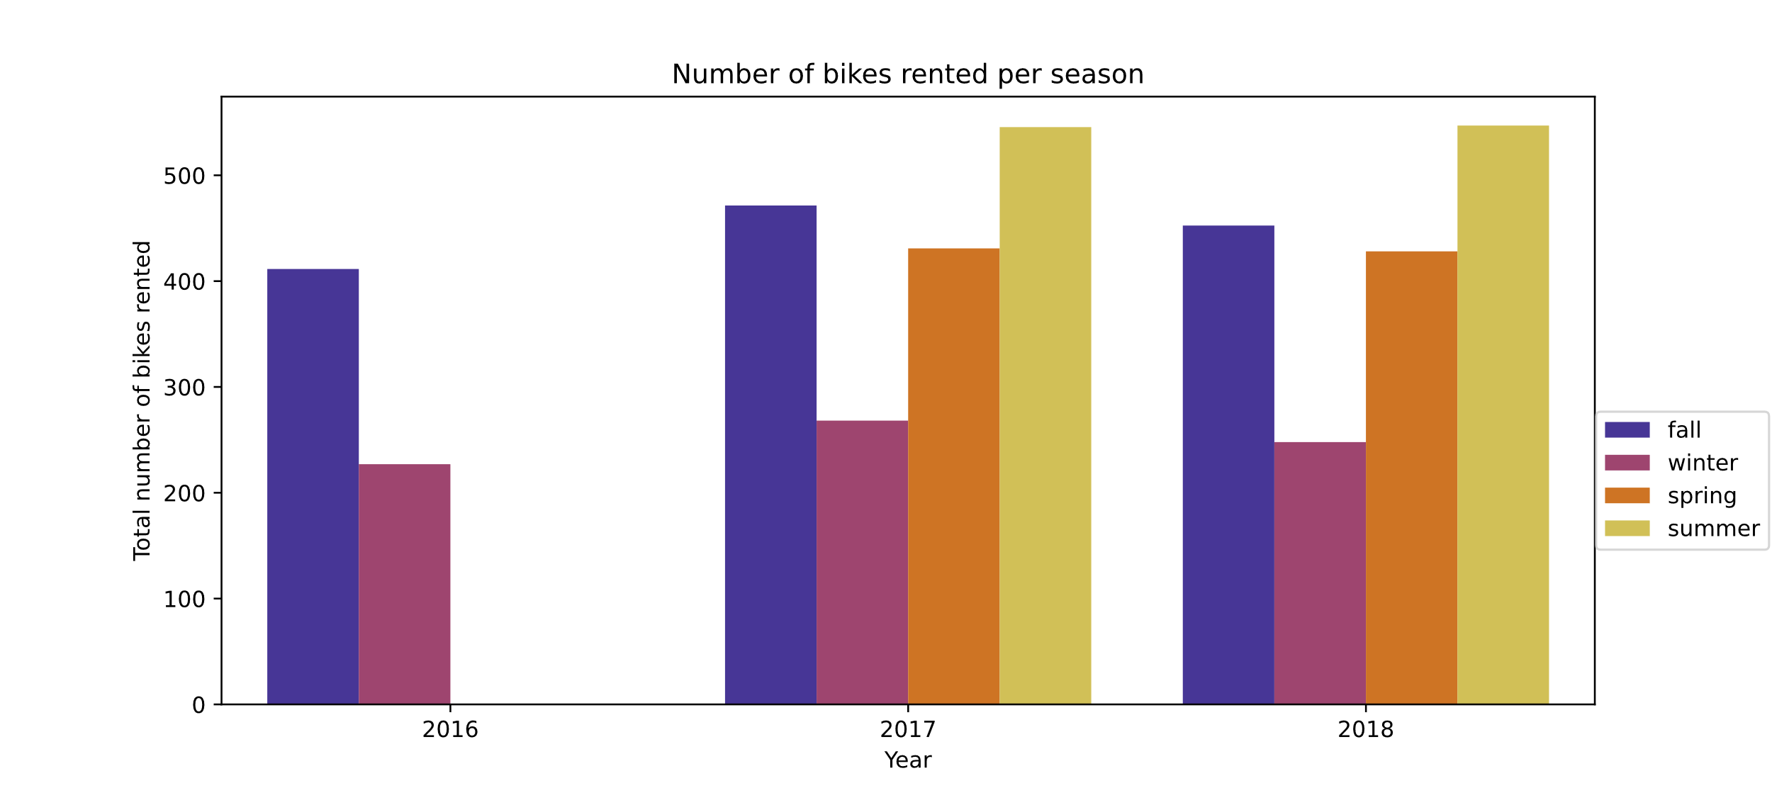
Analysis of demand based on season

Slide 8
Analysis of demand based on season
Demand is highly seasonal and greatly affected by weather conditions,
Obviously during rainy or windy days, very few rentals occur, except during the summer season
Promotional Offers could be performed to encourage rentals on bad weather and off seasons

Slide 9
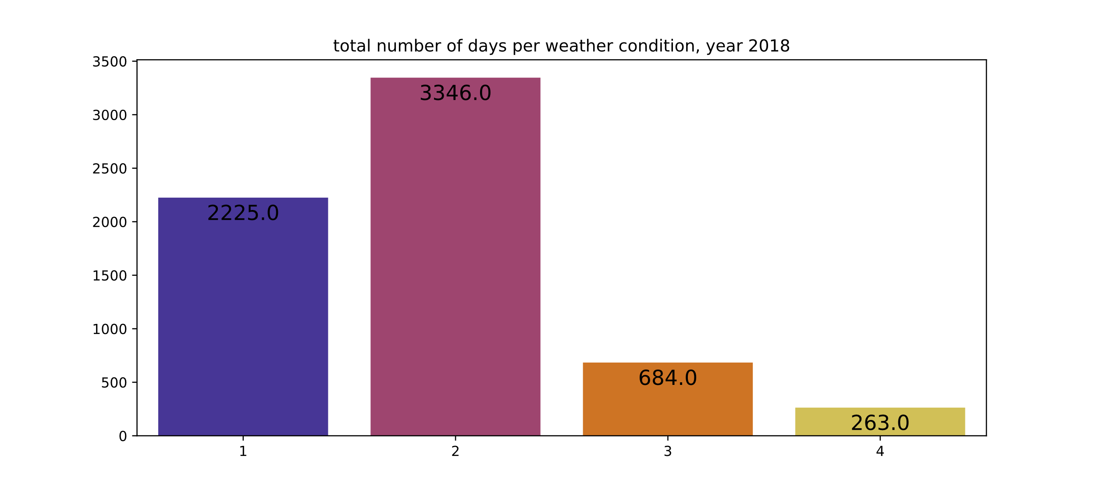
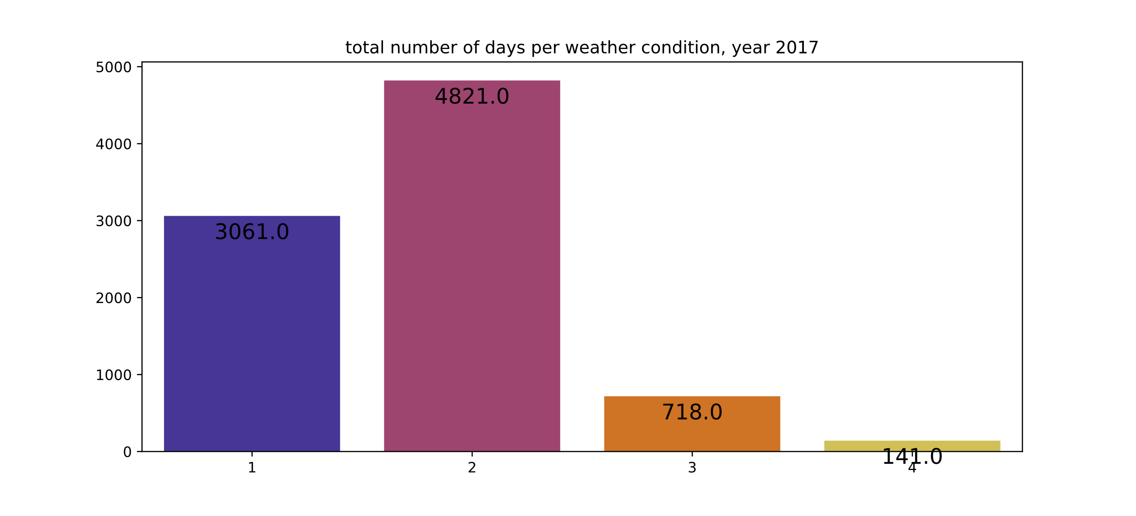
Total days with good/bad weather condition
Comparing both 2018 and 2017, we can see that it had almost double of very windy or rainy days,
We have less fair (1) conditions than “mostly cloud” (2), yet we have more bikes rented on fair conditions
Truly showing that good weather increases rentals, and since we can’t control the weather, we have to find incentives to increase rentals on bad days
Notes:
which could explain the reason they had more bikes rented in 2018 with bad weather conditions

Slide 10
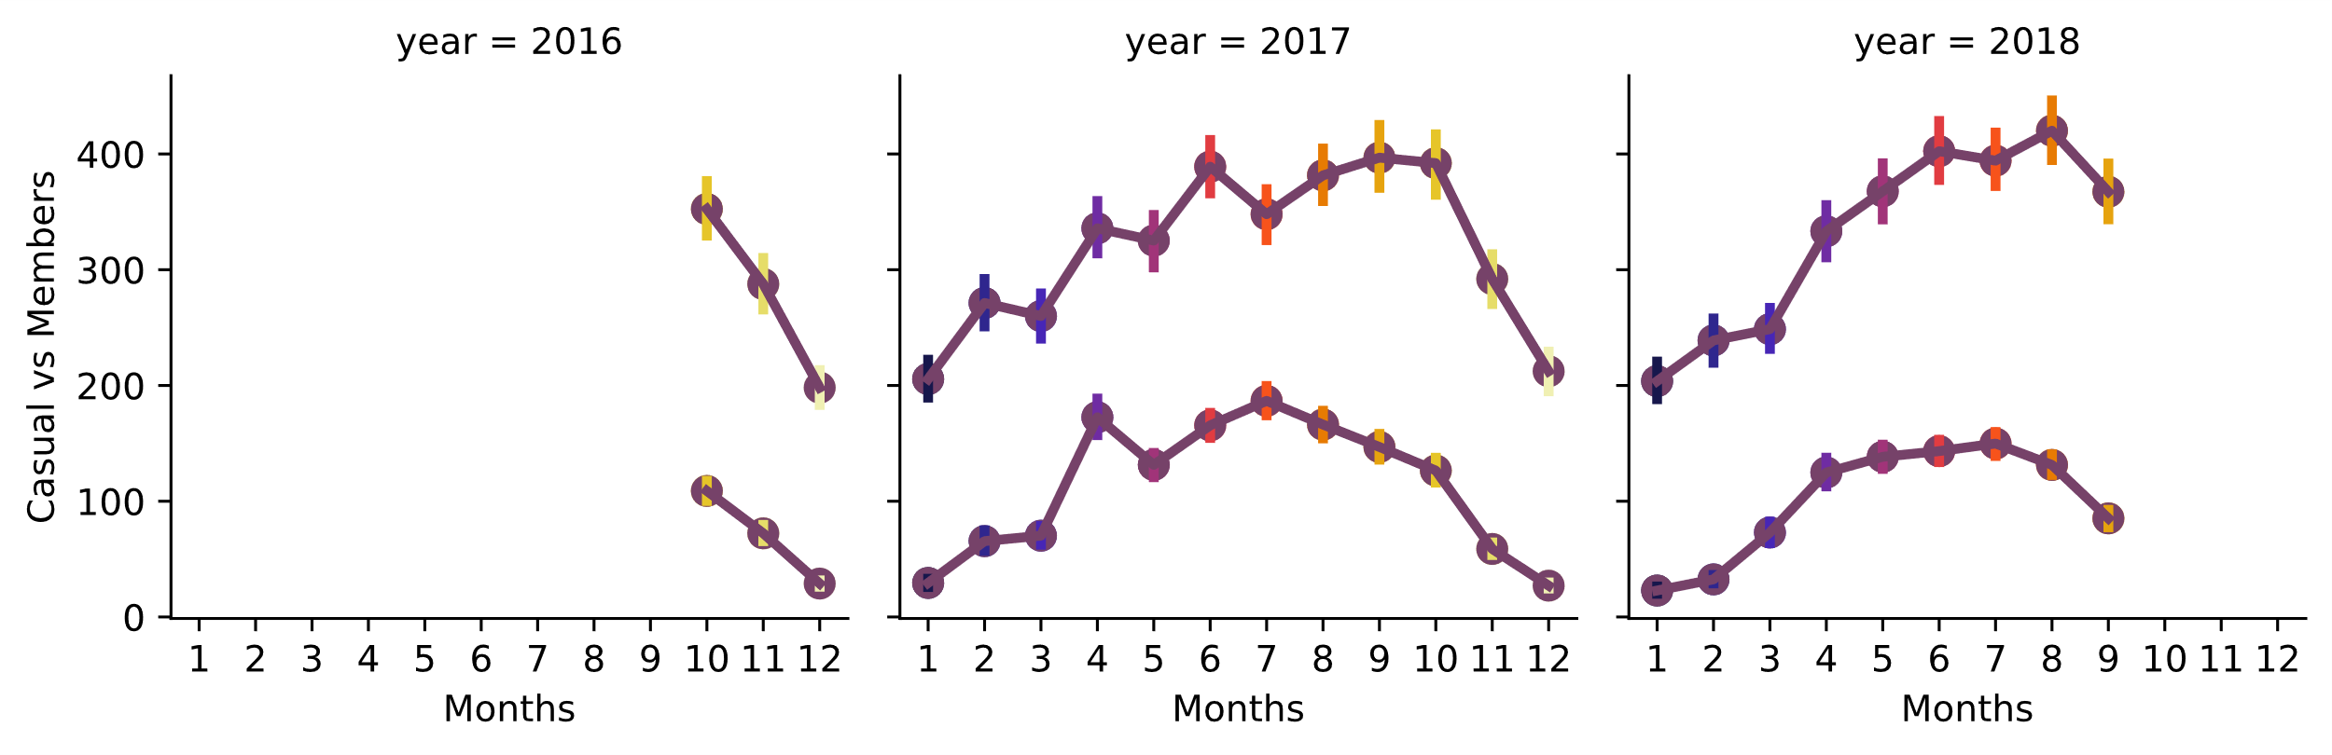
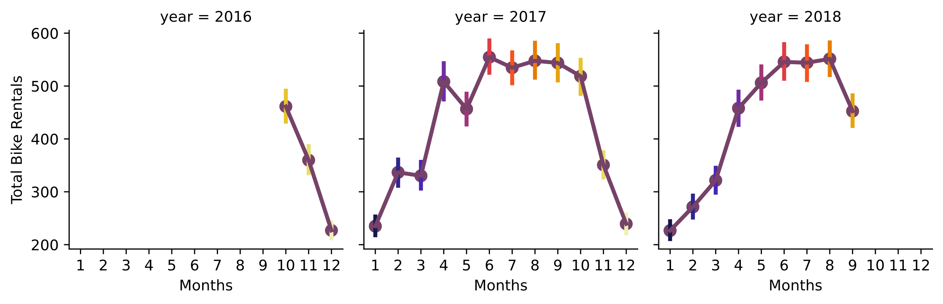
Monthly seasonal data

Slide 11
Monthly members vs casuals
Members and Casual riders follow the same pattern, weather conditions greatly affect the rental of bikes.
Finding proposals to make it a more pleasant ride
Finding promotions or group biking events
Creating closer Bike stations to make it a shorter ride

Slide 12
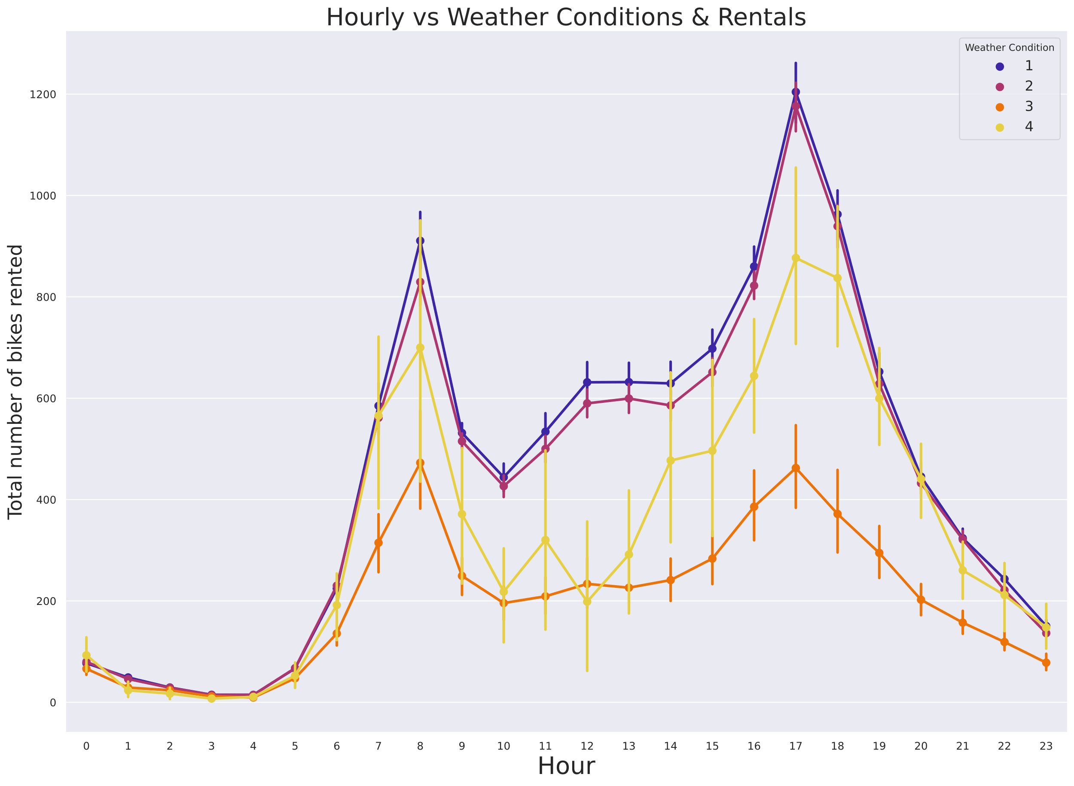
Hourly patterns vs weather conditions

Slide 13
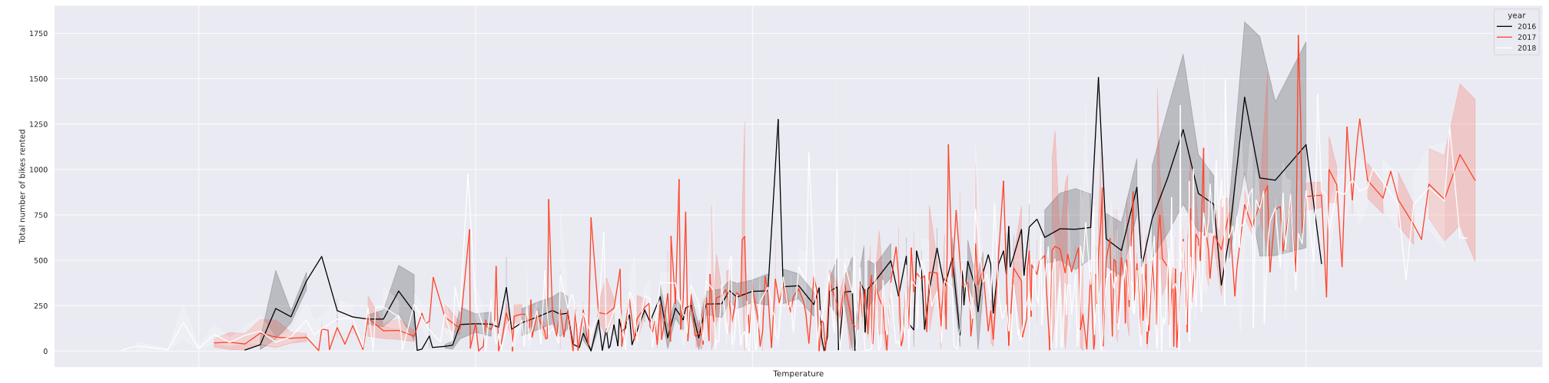
Temperature & rentals
Bike rentals and temperature are directly correlated, where an increase in temperature results in an increase in bike rentals.

Slide 14
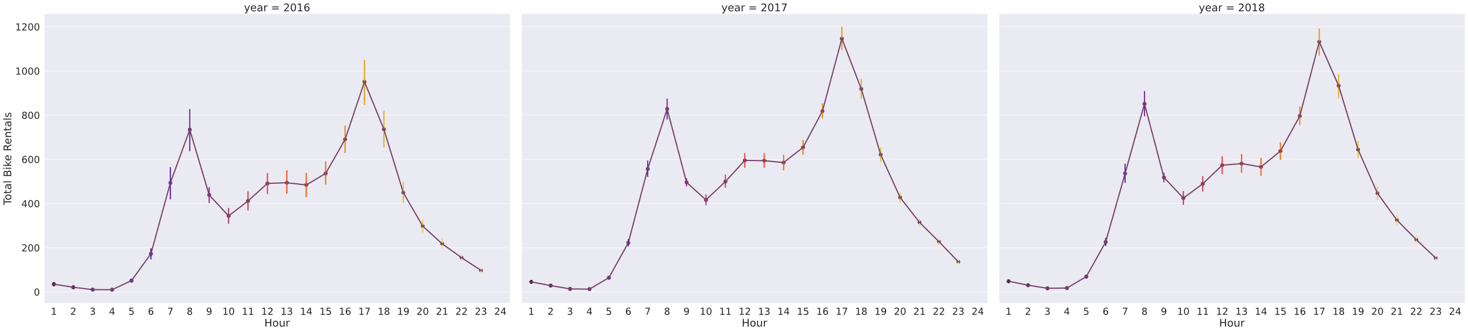
Hourly Data per year
The hourly data all follow a similar trend and pattern, our daily peaks are 7-9am and 5-7pm
Regardless of the year, they all follow the same pattern.
Riders could be either using their bikes to go to school or work, and not for recreational purposes.

Slide 15
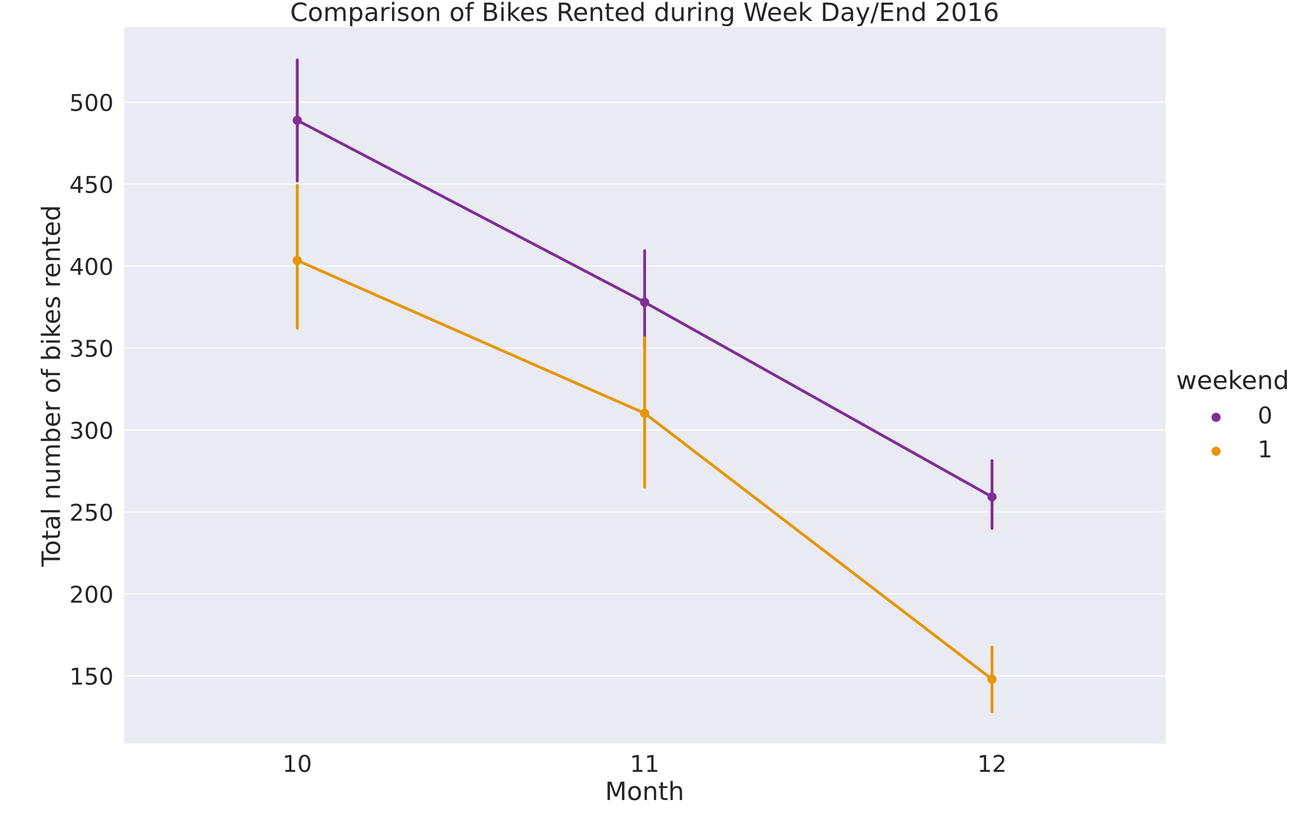
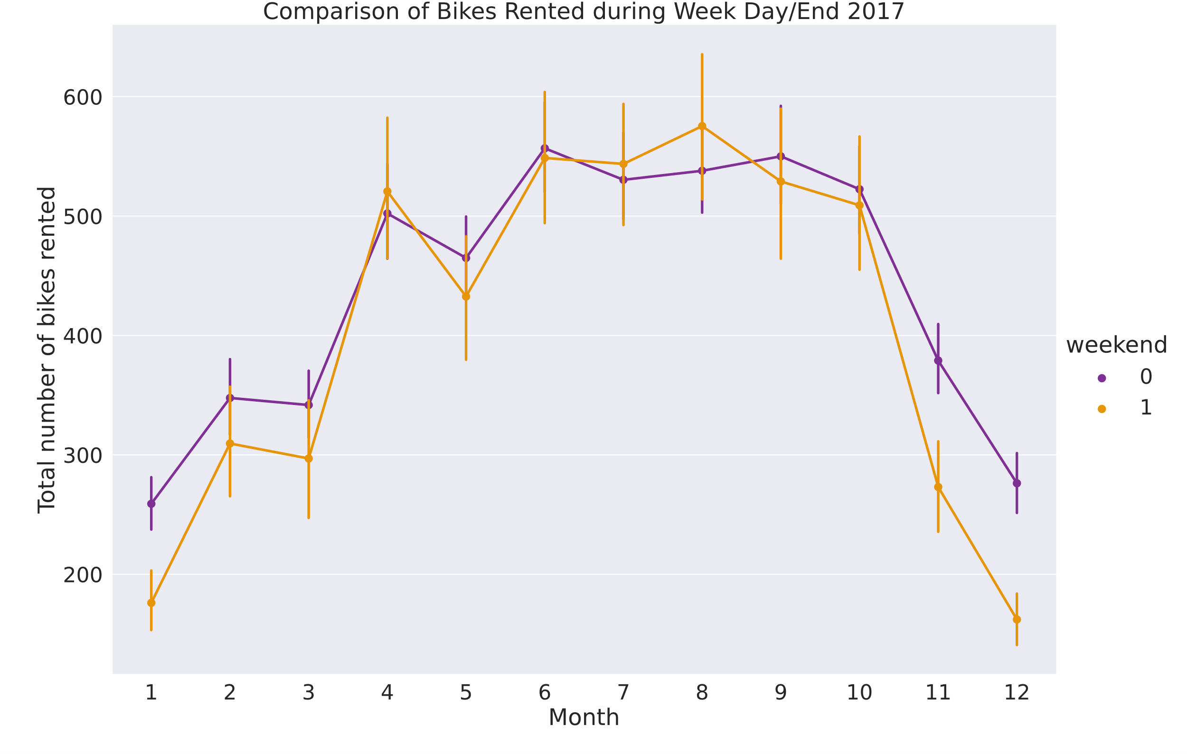
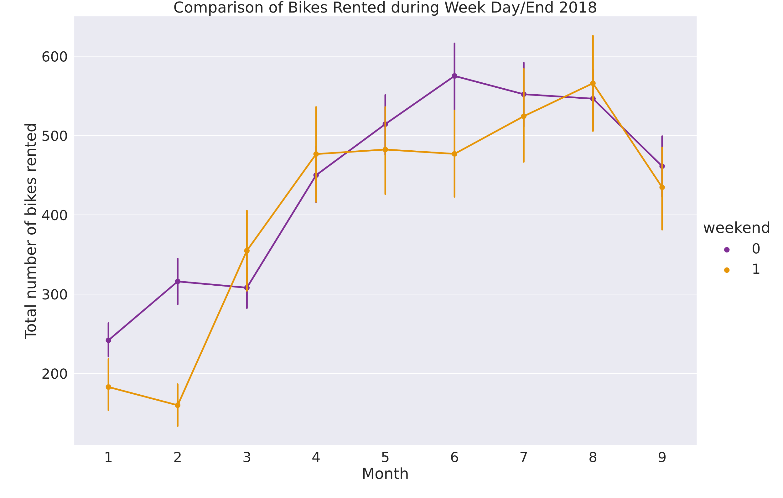
Weekend bike rentals

Slide 16
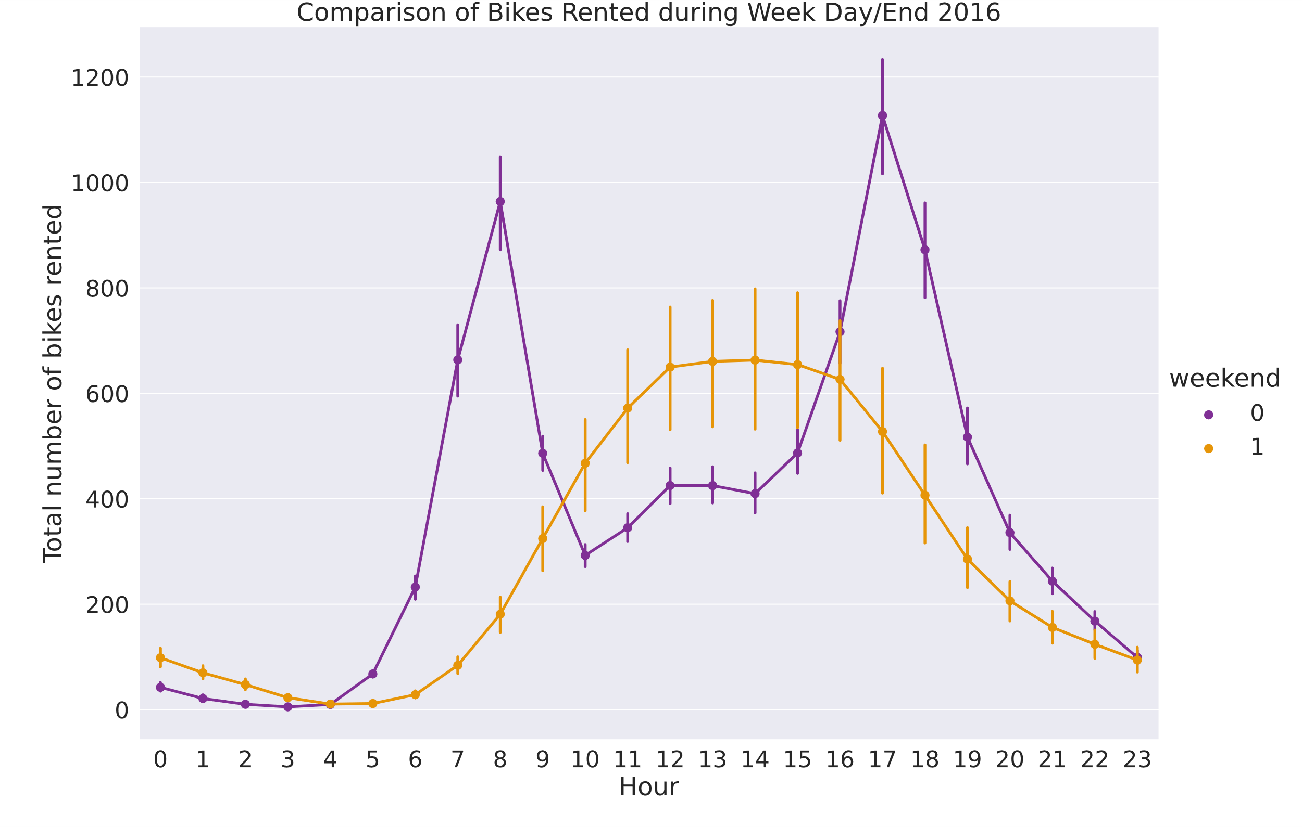
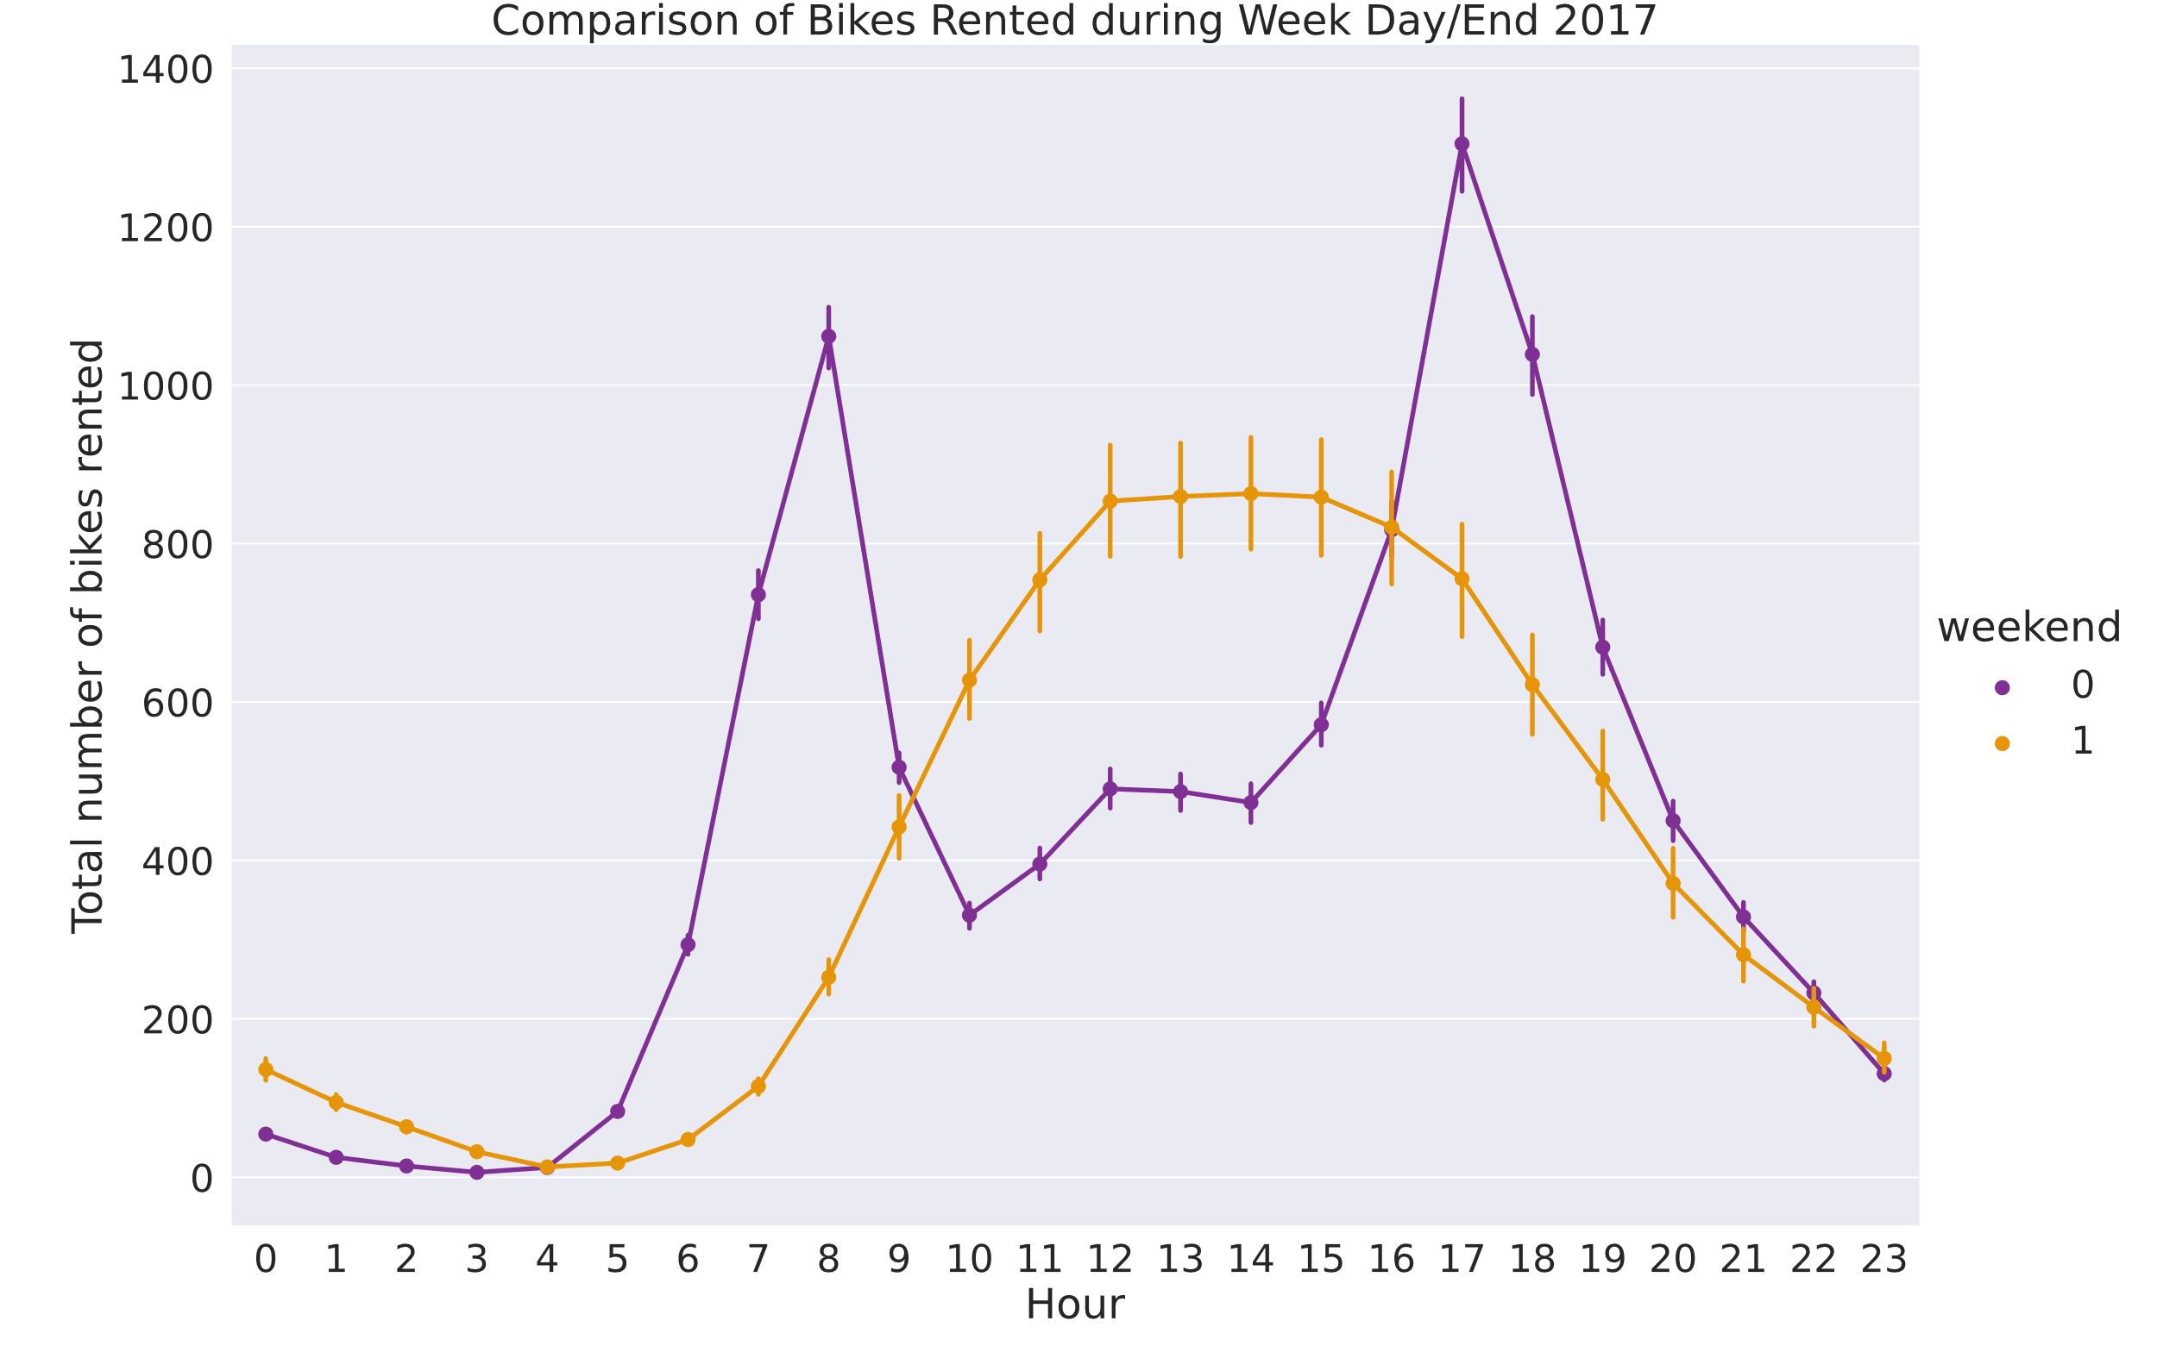
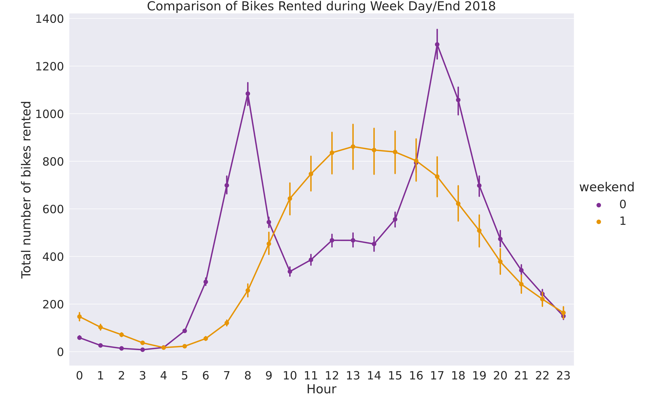
WeekDay/End Hourly Patterns

Slide 17
Weekday/End Hourly Patterns
Weekdays have peak rentals are during work/school commuting
Weekends shows more recreational rentals, where peak times are around noon
Regardless most rentals are for commute
Notes:
Looking at the hourly pattern based on weekend or weekday, we see that the peak times during the week is for school/work, while during the weekend is more of a recreational

Slide 18
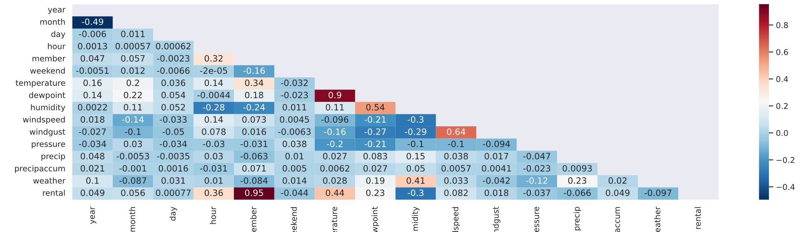
Feature correlation
Machine Learning models need little correlation between its independent variables to avoid multicollinearity.
One of the first steps in machine learning models is to highlight dependent features through a Heatmap of the correlation matrix.
Notes:
Multicollinearity is the resultant of having two independent variables that are highly correlated, thus increasing computational power needed to run the model with no obvious gain, as well increase possibility of overfitting the model.
As we can see in the above chart, we have very little features that are correlated, except maybe some of the weather features, like temperature and dewpoint, windspeed and windgust, member and rental obviously, and a slight correlation between rental and temperature, and rental and hour

Slide 19

Correlation of features
Weather Features have correlation
Temperature and Dewpoint
Windspeed and Wind gust
Bike Rentals Slight Correlation
Rentals and Temperature
Rentals and Hour
Looking at this correlation we could deduce several features that could be discarded, Dewpoint and Wind gust, as they are already correlated to temperature and windspeed, or we could use one of the feature selection methods covered in the next slides,
Notes:
As we can see in the above chart, we have very little features that are correlated, except maybe some of the weather features, like temperature and dewpoint, windspeed and windgust, member and rental obviously, and a slight correlation between rental and temperature, and rental and hour

Slide 20
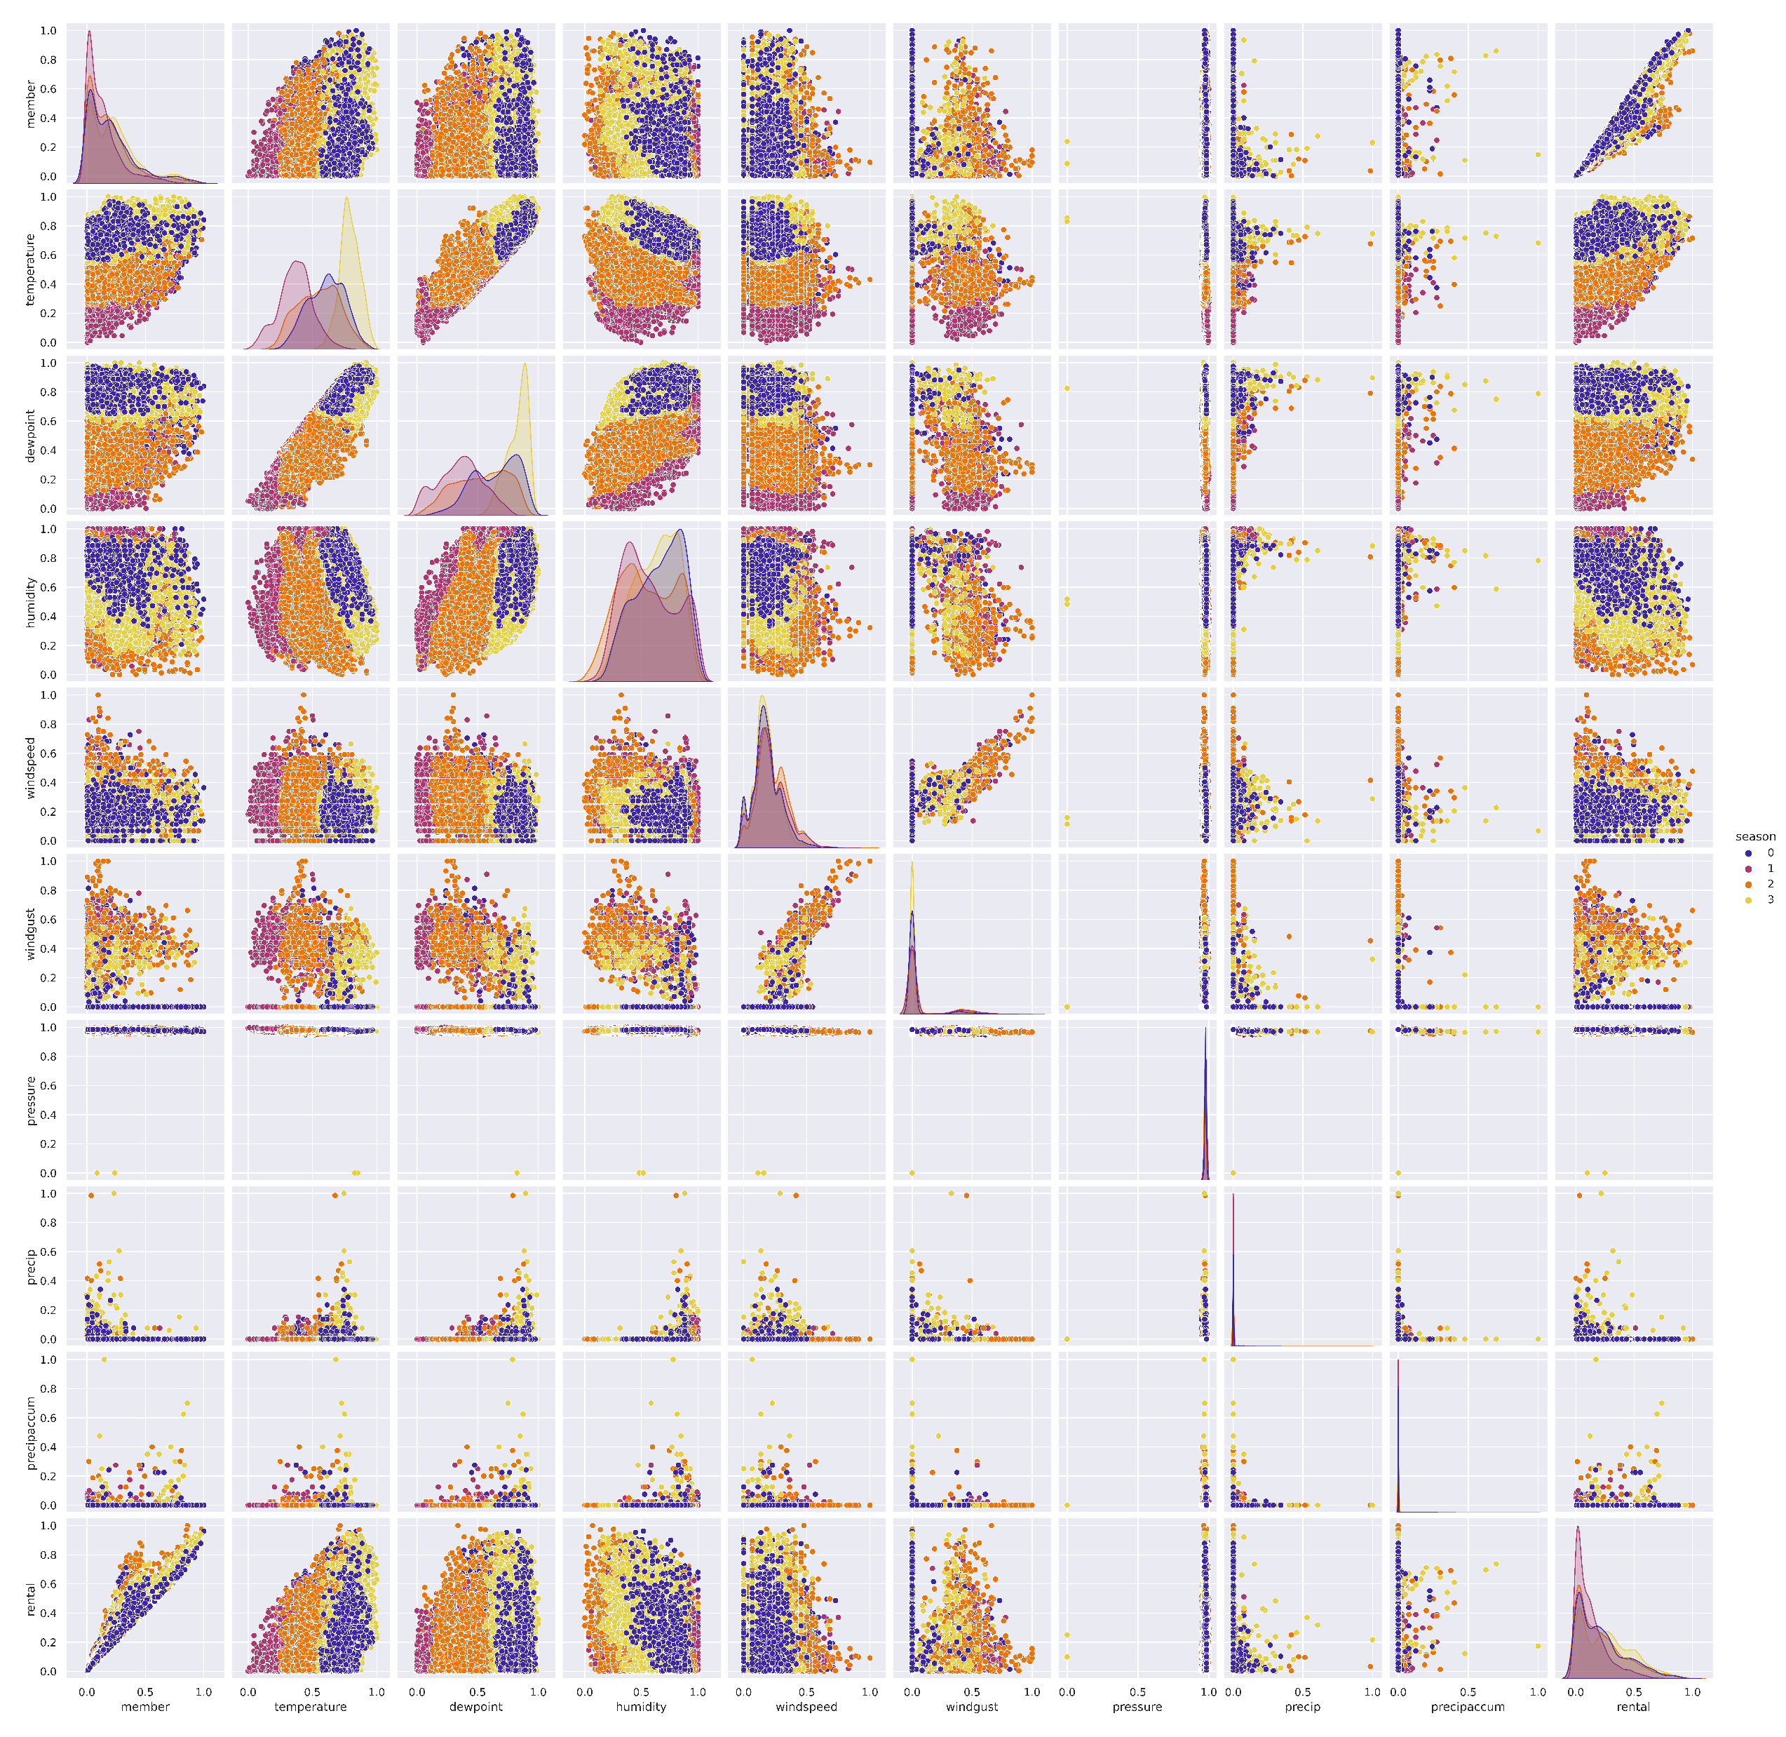
Pair plot between features

Slide 21

Storytelling resultant on model
After our analysis of the data, we could deduce several things.
Temperature data are highly correlated, some features could be discarded from our model,
There is a large seasonality in the data, and bike rentals are highly affected by the weather
Our Member behavior follows two different patterns, one during the week, where riders are commuting to work/school, and a second that follows a more recreational pattern during the weekends

Slide 22
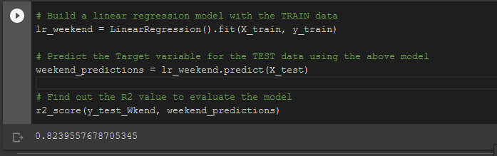
Linear regression
One of the ways to predict future rental demand to better be able to evaluate the risk the company is taking; we use Linear Regression.
Our team performed a Linear regression learning from the two years provided by Capital Bikeshare, and was able to perform a prediction accuracy from the start of almost 82 percent

Slide 23
Machine Learning Prediction
After our first phase of storytelling, we could deduce that the user behavior follows two different patterns, a weekday pattern, and weekend pattern
For the first model, our team divided the dataset into weekends and weekdays
Weekend model is performing an 82% accuracy on test data, while weekday model is performing a 96% accuracy on test data, which is probably overfitting
Notes:
After fitting the model, we realized that the weekday model is overfitting and achieving an accuracy level of 96% on the test data, while the weekend model is performing slightly better and has an accuracy of 82% which shows little overfitting

Slide 24
Hyperparameter optimization
One way to increase a model accuracy and efficiency is to optimize all the different variables it deals with, like the regularization variables, the learning rate, etc…
Tweaking each variable manually would take forever, so to best utilize our time, we use a gradient boosting model that optimizes our variables by slightly tweaking them until it reaches a minimum cost (best result)

Slide 25
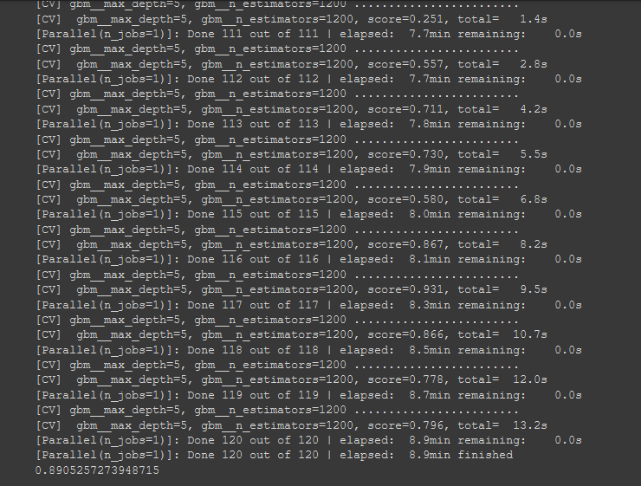
Gradient boosting regressor
After hyperparameter optimization, we were able to increase our model accuracy by 7%, which results in a final accuracy of 89% accuracy on the test data set for both models, which could have improved the overfitting issue in the first Week Day model

Slide 26
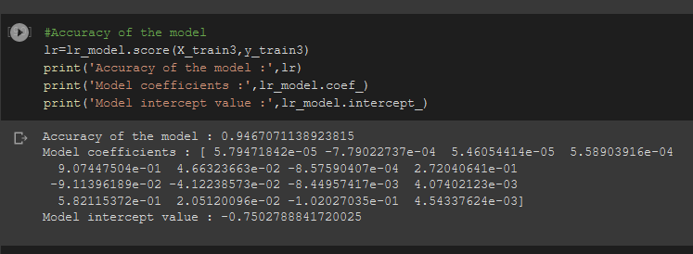
Machine Learning Using All Features
After creating a model with all features included using regular linear regression, the model performed an accuracy level of 94% on our test data, where we could also deduce that the model might be overfitting

Slide 27
What to do with current model
We could do several things, first prove that the model is overfitting by testing it on actual data, and compare model prediction,
Use feature selection technique to reduce the features that are correlating.
Try different regression or decision tree models to test it on the data
LSTM
Xgboost
Prophet
Increase the data being inputted into the system, and try to find the features that improve the model data

Slide 28
Principal component analysis (PCA) & t-distributed stochastic neighboring entities (t-sne)
Feature selection and Dimensionality Reduction

Slide 29
Mathematics behind Principal component analysis
Take the whole dataset consisting of d+1 dimensions and ignore the labels such that our new dataset becomes d dimensional.
1
Compute the mean for every dimension of the whole dataset.
2
Compute the covariance matrix of the whole dataset.
3
Compute eigenvectors and the corresponding eigenvalues.
4
Sort the eigenvectors by decreasing eigenvalues and choose k eigenvectors with the largest eigenvalues to form a d × k dimensional matrix W.
5
Use this d × k eigenvector matrix to transform the samples onto the new subspace.
6

Slide 30
Mathematics behind t-distributed stochastic neighboring entities (t-sne)
Calculating a joint probability distribution that represents the similarities between the data points.
1
Creating a dataset of points in the target dimension and then calculating the joint probability distribution for them as well.
2
Using gradient descent to change the dataset in the low-dimensional space so that the joint probability distribution representing it would be as similar as possible to the one in the high dimension.
3

Slide 31
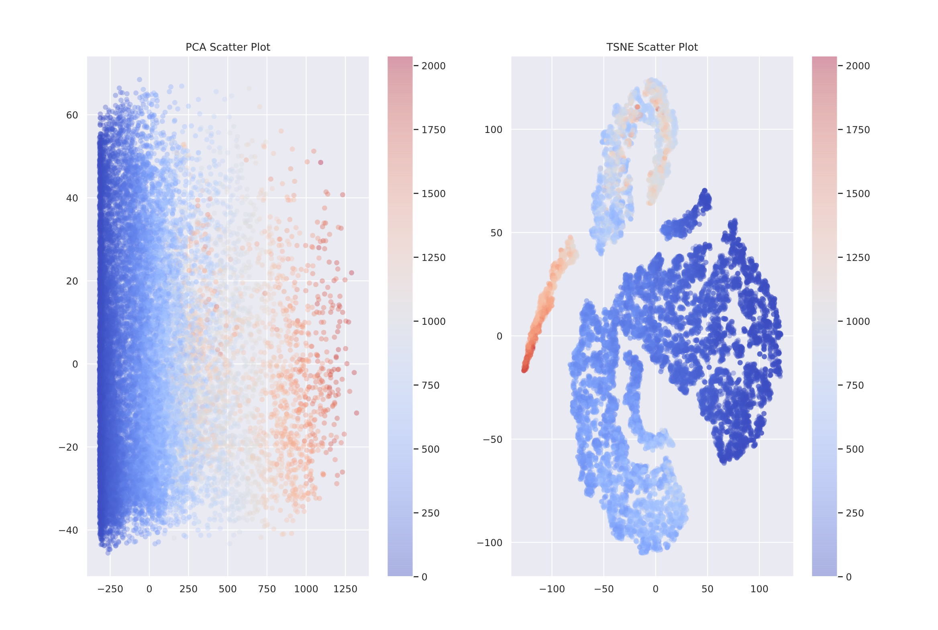
Pca and tsne feature selection
In the given plot we can see the transformed data through both PCA and TSNE and see how the data has been reduced to two features
The benefits of reducing our number of features provides a lower compilation for our model, since the size of the data is reduced, it is less costly to deploy, and more efficient to run

Slide 32
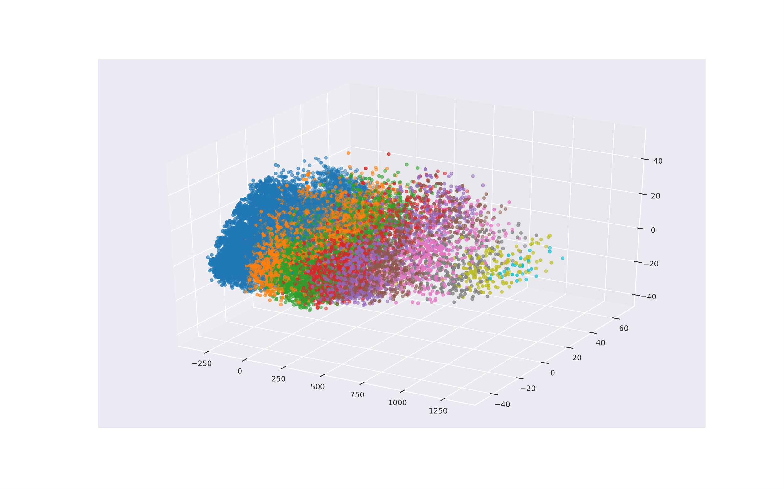
PCA with three features
We can control the number of features that we would like to keep, in this example chose three features
Benefits of increasing the number of features would be improving the model accuracy

Slide 33
In conclusion
After looking over the data, analysis and the story the given data tells, we could deduce the following
Data is seasonal, giving an opportunity to expand the current bike rentals during the offseason (fall and winter) and be prepared during the high season (spring, and summer)
The peak times during the weekdays are between 7am – 10am and 4-7pm, the off times could be good to reallocate empty stations, as well as offer promotions to casual drivers
Machine learning models could be utilized to direct the bikes to the stations that need the most, where the model with the current data is strong enough to start testing on real data to see its actual performance.

Slide 34
In conclusion
The machine learning algorithm steps to deployment
Deploy the model and test the two models over the actual data to see prediction accuracy on real data
Keep tuning the data and teaching it the new data
Add additional features to the model in order to benefit from its power, and reallocate the bikes to the needed stations
Increase promotional ads and marketing tactics during the low prediction periods

Slide 35

Steps to running notebook
First step to running notebook is to load it through jupyter notebook or google colab or any python notebook software of preference
Upload the necessary files (with the below exact names)
bike_sharing.csv
bike_case.pdf
bike_silhouette.png
Run All cells
(to see plots uncomment plt.show() and comment the plt.savefig & plt.close() lines)

